Slide 1
Big Ideas in Econ
Parting Thoughts with Mr. Davis

Slide 2

ECONOMICS IS ABOUT CHOICES!
You have to learn to make the best choices, so that you can be happy.
Be willing to sacrifice now for success later.
Is today a good day or a bad day? Either way you’re correct, choose to see the positive, today is a good day because your are alive… What are you going to CHOOSE TO DO WITH YOUR LIMITED TIME to make the most of today?

Slide 3

Speak your mind… get out and vote
WHO DO YOU SIDE WITH?
Register to Vote Absentee?
Look at Politician’s Proposed Spending!

Slide 4
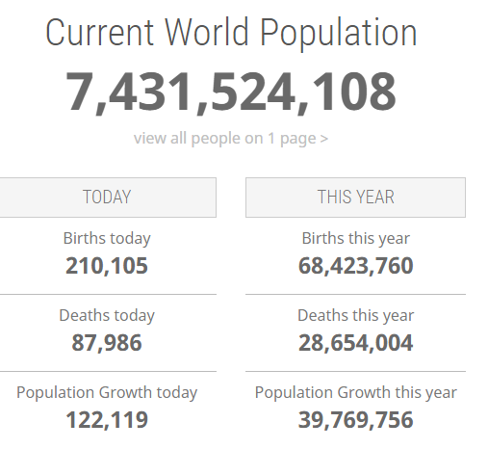
Competition in Labor
There are 7.4 Billion People competing on this planet to be happy… this means we have to learn to get along and YOU have to be willing to work hard to carve out your place in our global economy.

Slide 5
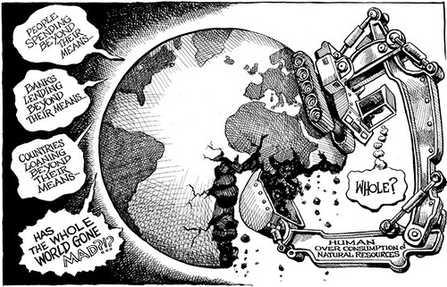
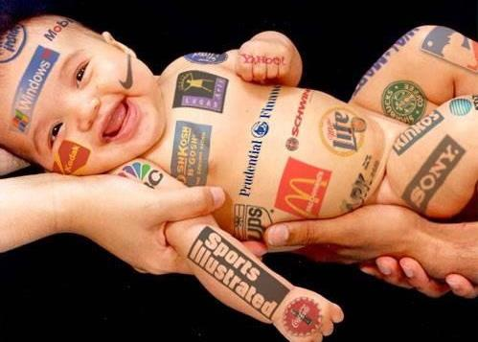
Profit vs. Planet
We want to grow the economy to give everyone a happy life, demand for products is INFINITE…
However Scarcity has limited our resources to meet this demand.
How do WE Fix it? Everyone has to step up
We have to consume less, and learn to be content and happy outside of just buying and consuming things

Slide 6

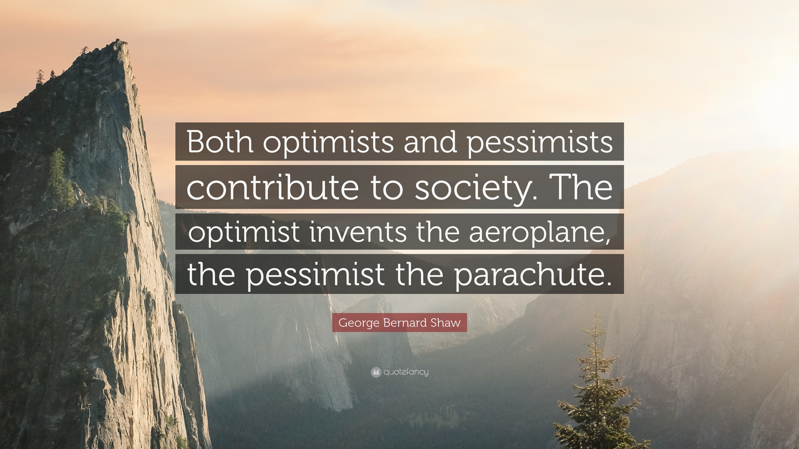
Be Kind… we all want to avoid pain and seek out happiness
Be good to your fellow person, believe in the goodness of people and work hard to contribute to the life and society you want.

Slide 7


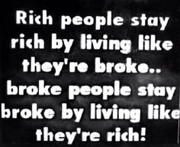
Debt is Dumb
Try to avoid debt (home/car/college for a career) is okay
NO HIGH INTEREST RATE DEBT
  No credit cards
  No 10% Interest and above
  Excessive Debts can cause stress, divorce, unhappiness

Slide 8

Till Next Time…
Learn from the mistakes
and
Reflect on the choices
I wish you all the best of luck on your adventures towards success and happiness
Remember to WORK HARD –then- PLAY HARD and LOVE LIFE!
Please feel free to come back to visit and share your stories with me.
Much love to ALL of you…
-Davis

Slide 9
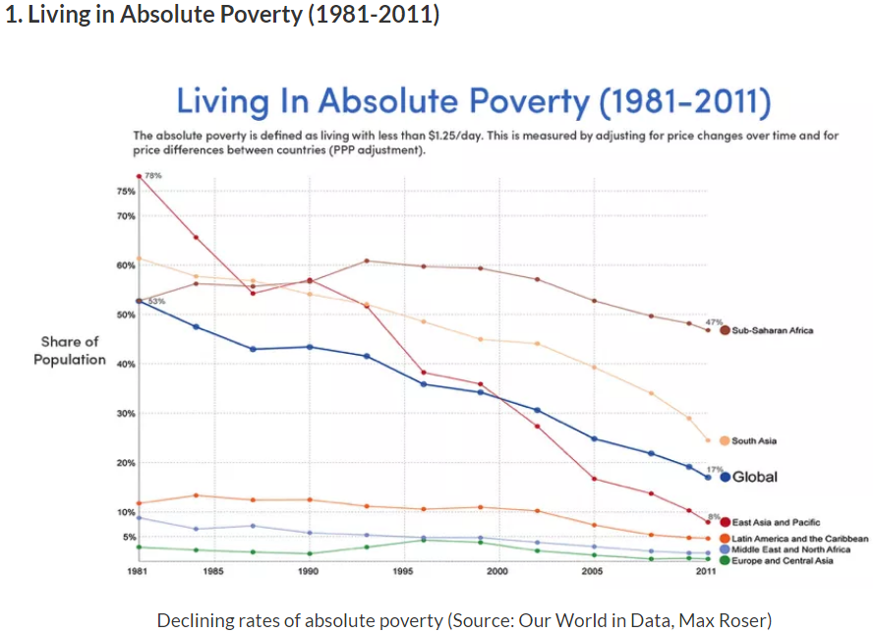
Why The World is Better Off ?

Slide 10
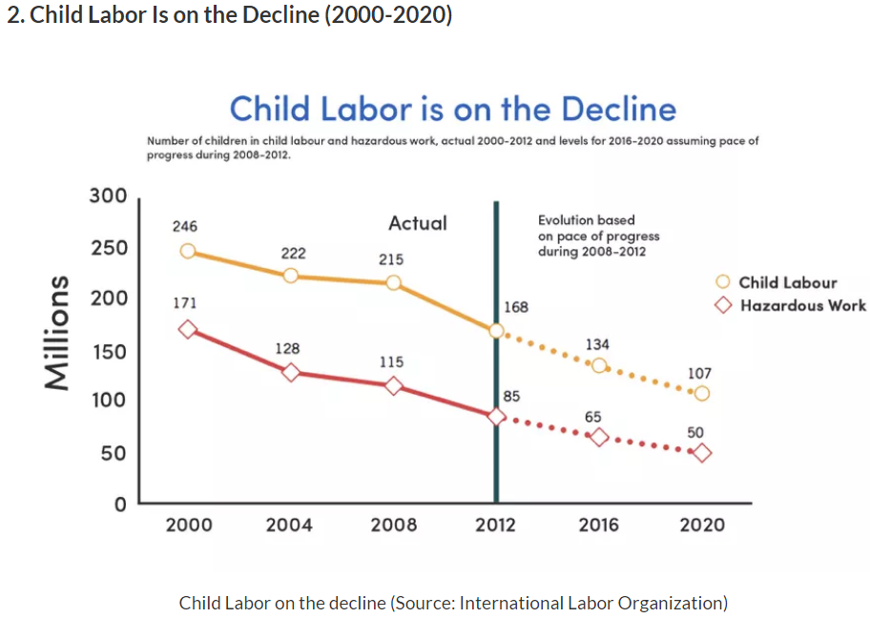
Why The World is Better Off ?

Slide 11
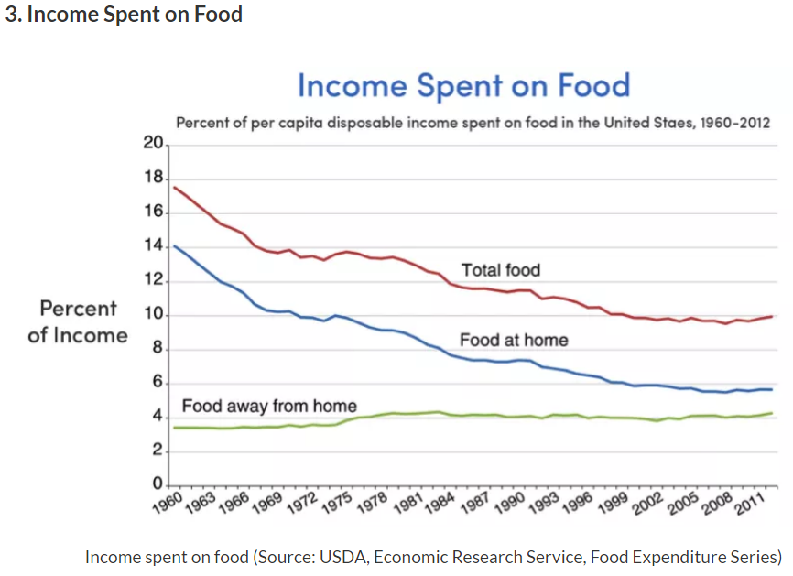
Why The World is Better Off ?

Slide 12
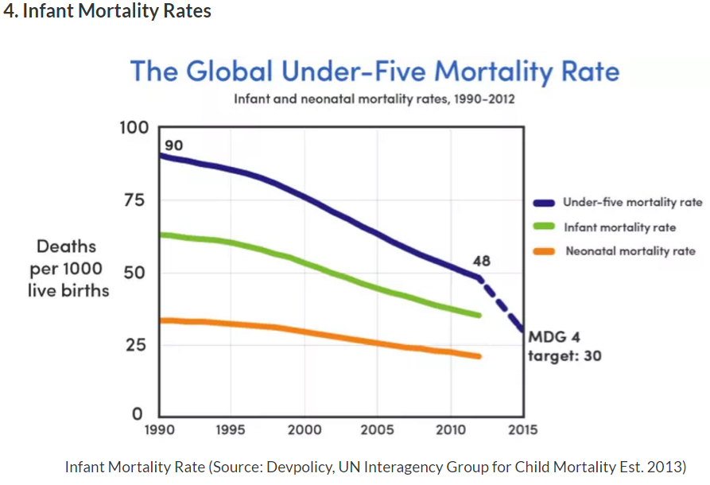
Why The World is Better Off ?

Slide 13
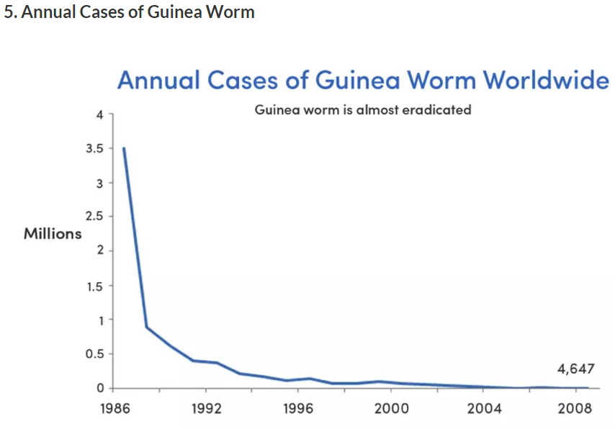
Why The World is Better Off ?

Slide 14
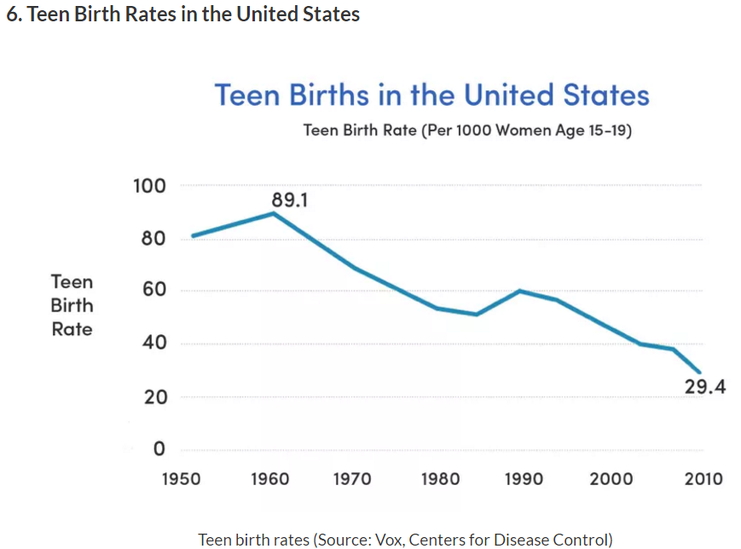
Why The World is Better Off ?

Slide 15
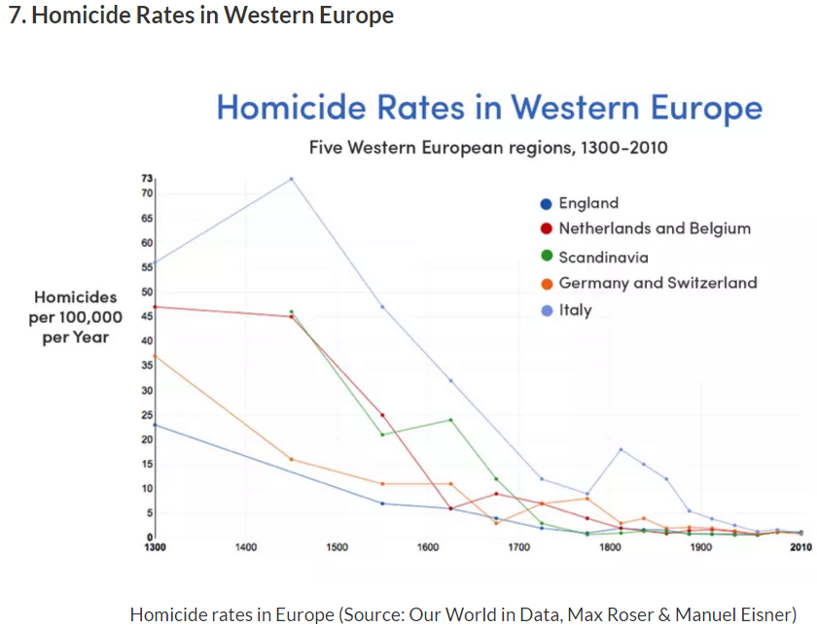
Why The World is Better Off ?

Slide 16
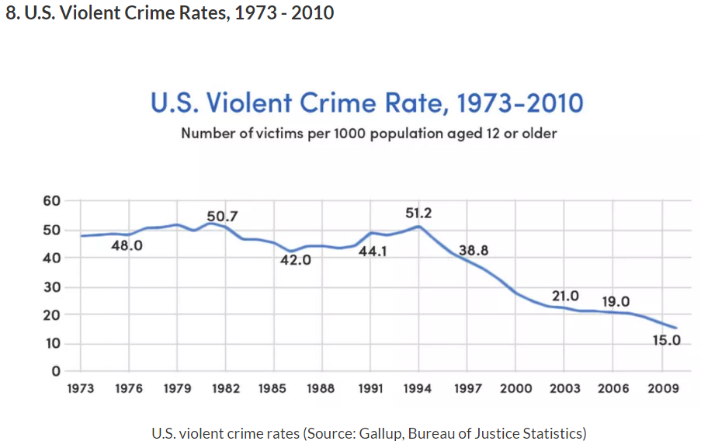
Why The World is Better Off ?

Slide 17
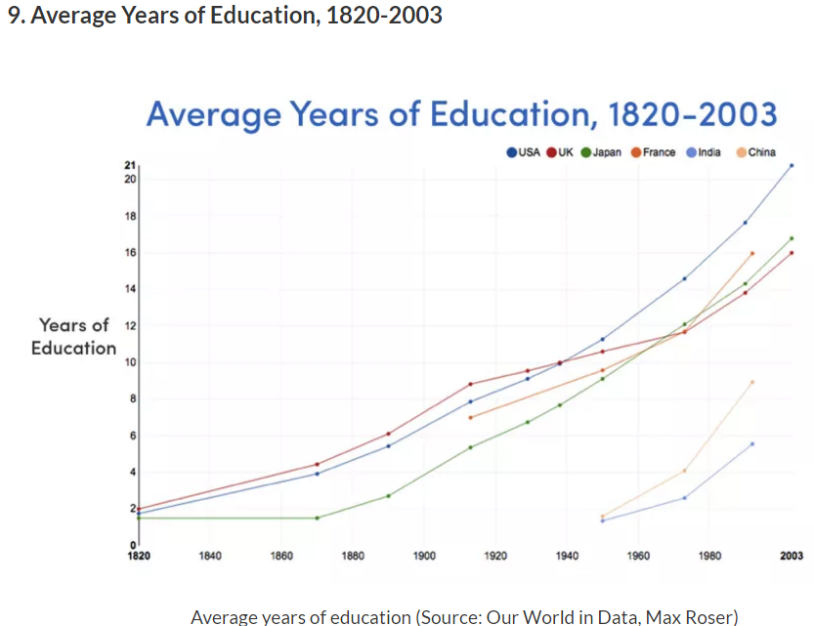
Why The World is Better Off ?

Slide 18
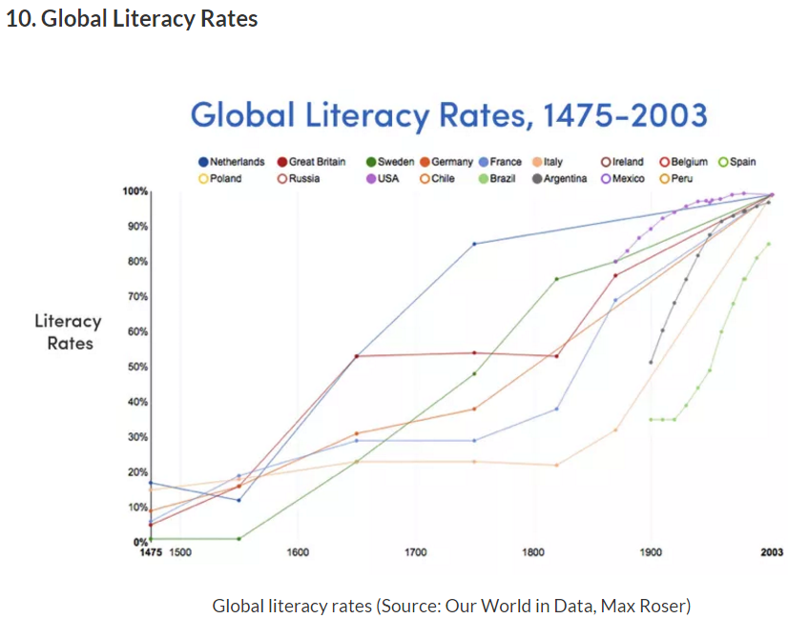
Why The World is Better Off ?

Slide 19
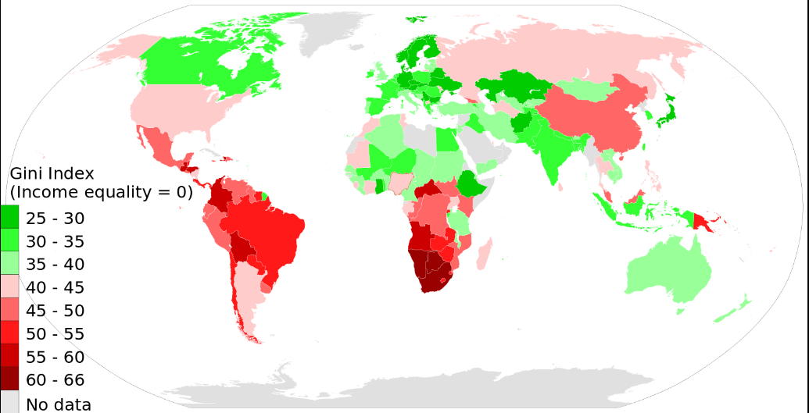
Income Inequality – Gini Coefficient
Income inequality has been increasing in the united states…
Top 1% owns _______ % of the nations wealth?

Slide 20
Why The World is Better Off ?
CRISPR GENETICS
STEM CELLS

